Slide 1



Meaningful Yelp Data for Business Units & Users
Team: Attention Please! Chen Pengyao / LiYuan / Yumi Shin / ZhaoWei

Slide 2
Contents
Data Structure Overview
Design Requirements
Our Approaches to Design

Slide 3
Data Structure Overview
Business.json
Basic: Business_id, Name, Postal_code, Stars
Location: State, City, Address, Latitude, Longtitude
Open Hour: Open_state, Open_time
Menu Category: Taste, Type
Dataset: Yelp (website and mobile app)
Coverage: 11 metropolitan areas in
4 countries
Volume: 174,000 businesses,
5,200,000 user reviews
Used Dataset: Business, Reviews, Check-in
Reviews.json
Basic: Business_id, Review_id, user_id, Stars
Comment: Date, Text
Checkin.json
Check-in: Business_id, Date

Slide 4
Design Requirements
Analyze the relationship between the dates and the crowdedness
Visualize what kinds of restaurants in New York city
Business
User
Visualize the location of filtered restaurants near the user
Visualize the customers’ rating pattern
Gain insight into customers’ visit pattern and review
Search the restaurants as user-oriented criteria
Visualize the positive and negative reviews
Analyze the relationship between the customers’ rating and the review comments
Visualize how the selected restaurant matches user’s preference

Slide 5

Design Requirements
Word
Cloud
Horizon
Graph
Heatmap
Map
Parallel
Coordinates
River
Metaphor

Slide 6
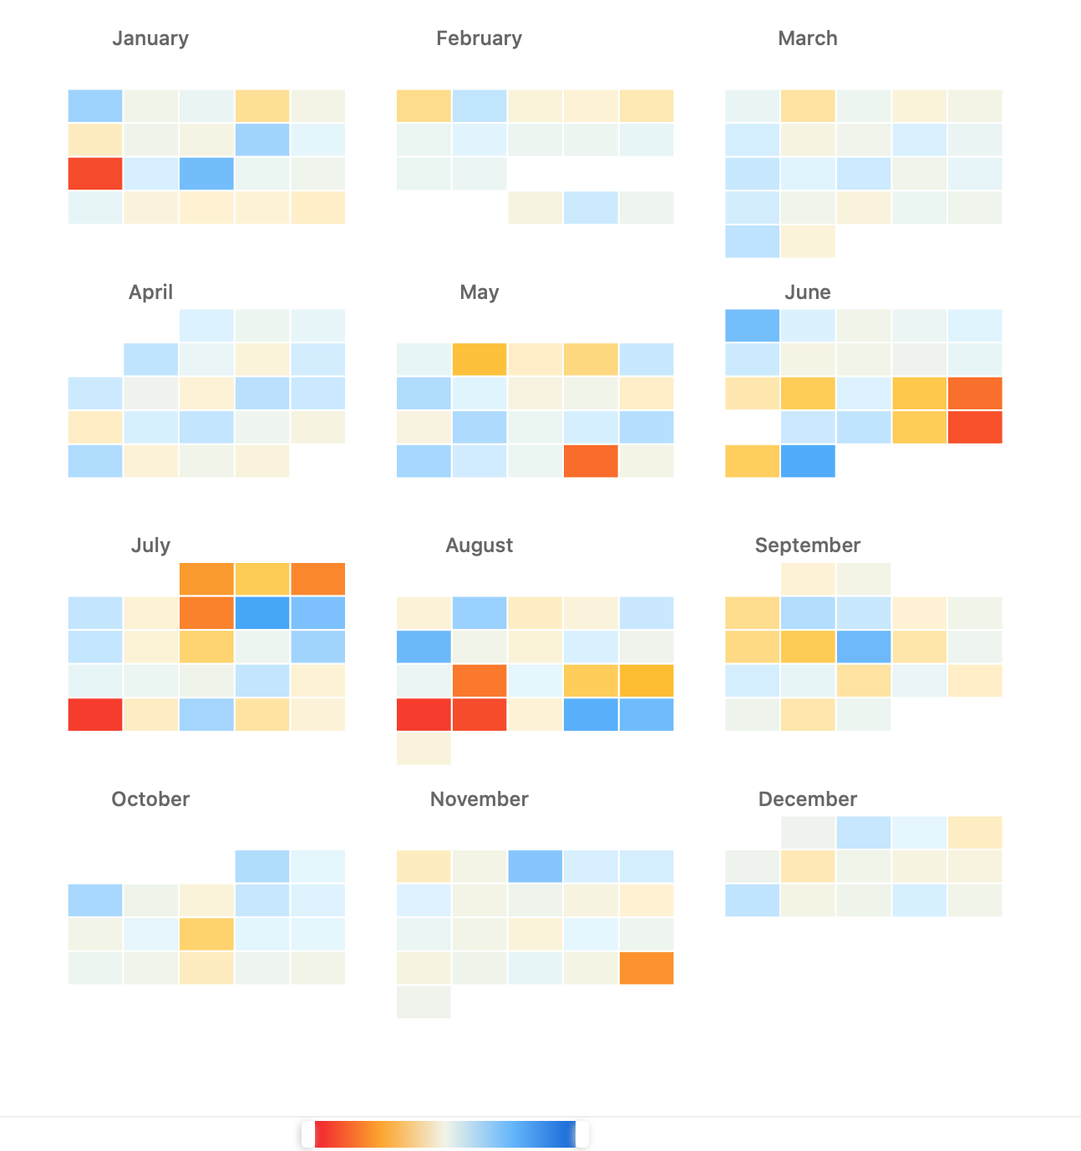
[Part 1] Business - Heatmap
Analyze the relationship between the dates and the crowdedness
Involves 12 months, 365 days business check in
The color of each square ranges from red to blue, which represents the numbers of check in of that day. Red represents less than average check in of that month, blue represents more than average check in of that month.

Slide 7

[Part 1] Business – Horizon Graph
Visualize the customers’ rating pattern
Involves 12 months, 365 days business stars
The color ranges from red to blue, which represents the average scores of that day, according to all stars given in that day.
Red represents negative, blue represents positive. The x-axis represents the whole years length, in which each part represents one day in the year.

Slide 8
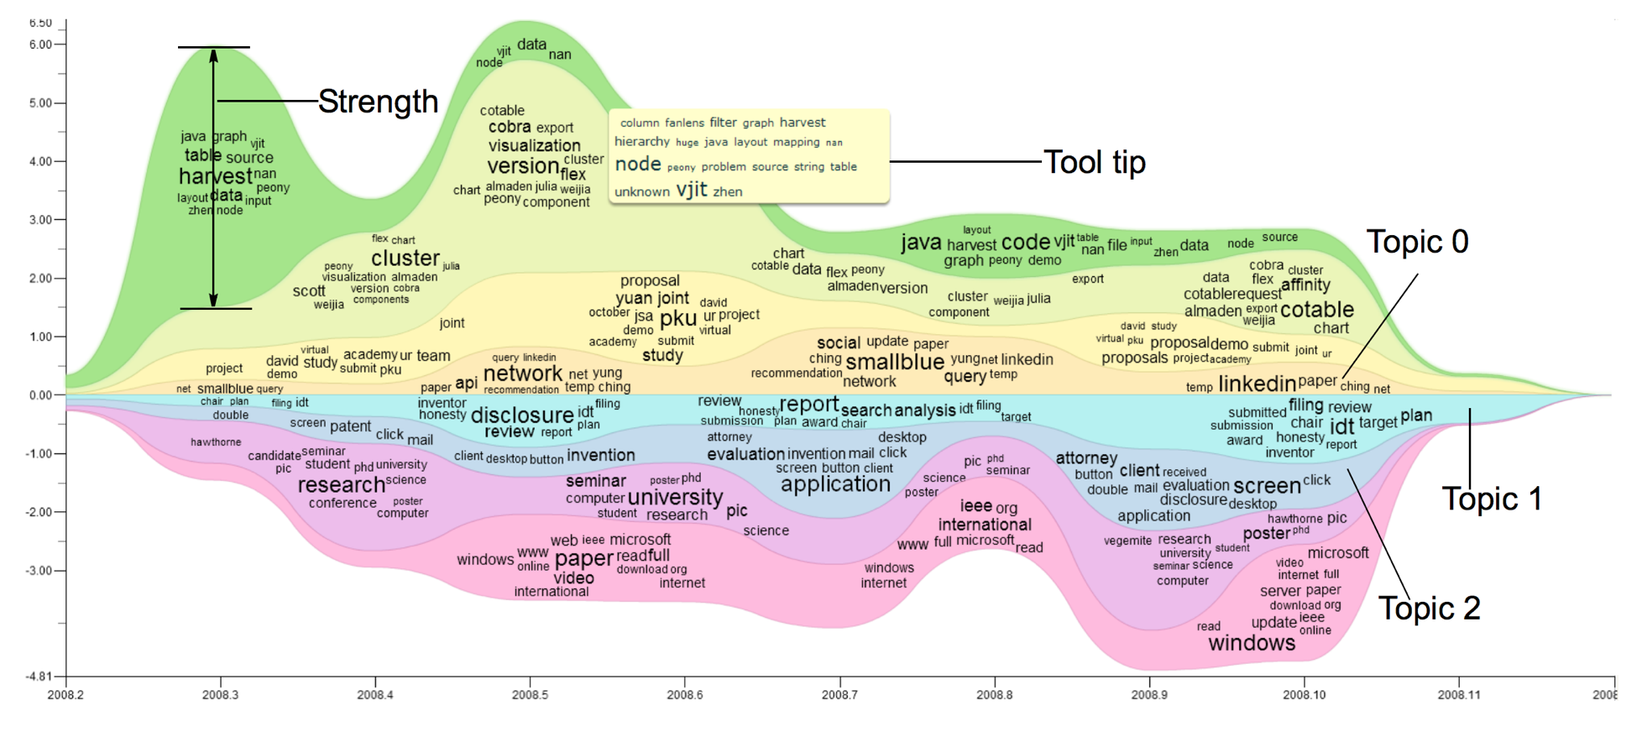
[Part 1] Business – River Metaphor
Analyze the relationship between the customers’ rating and the review comments
The y-axis represents the number of review, the x-axis represents the whole years length.
Each color represents one star, with word cloud in it.

Slide 9
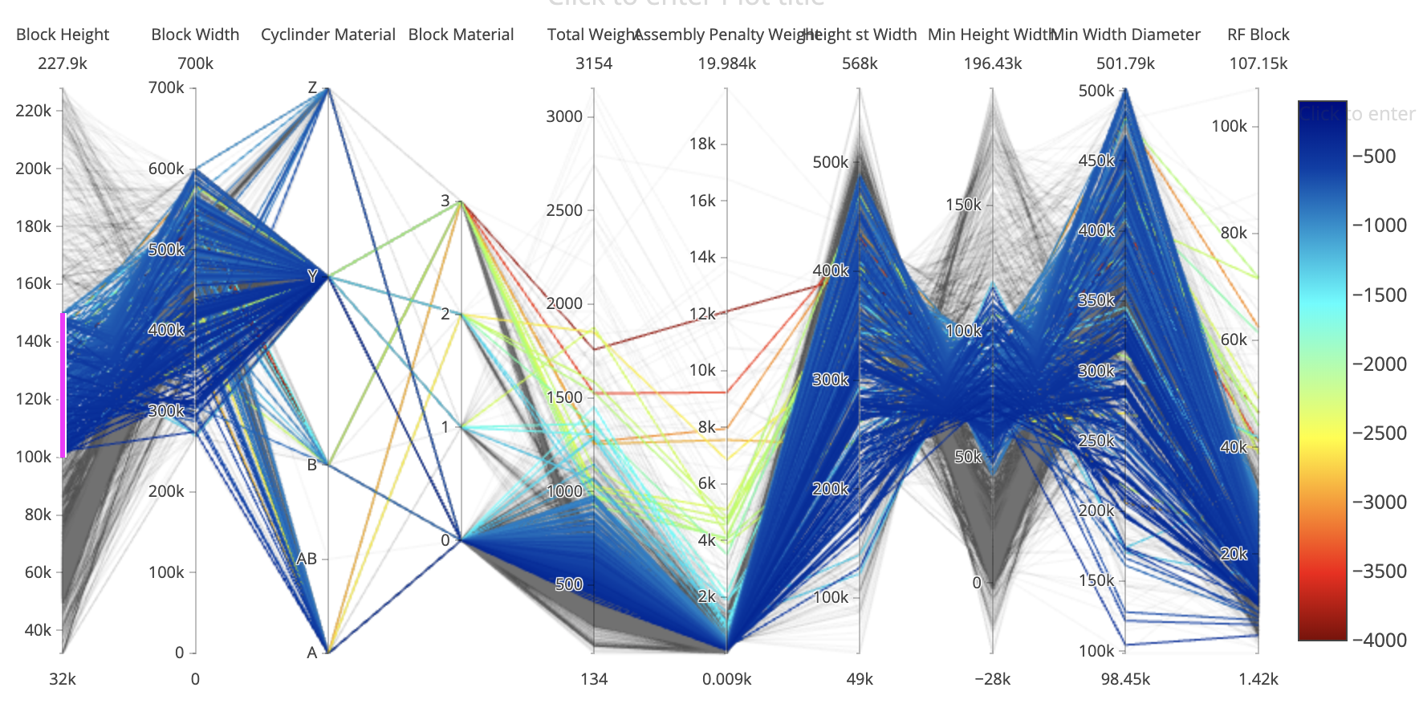
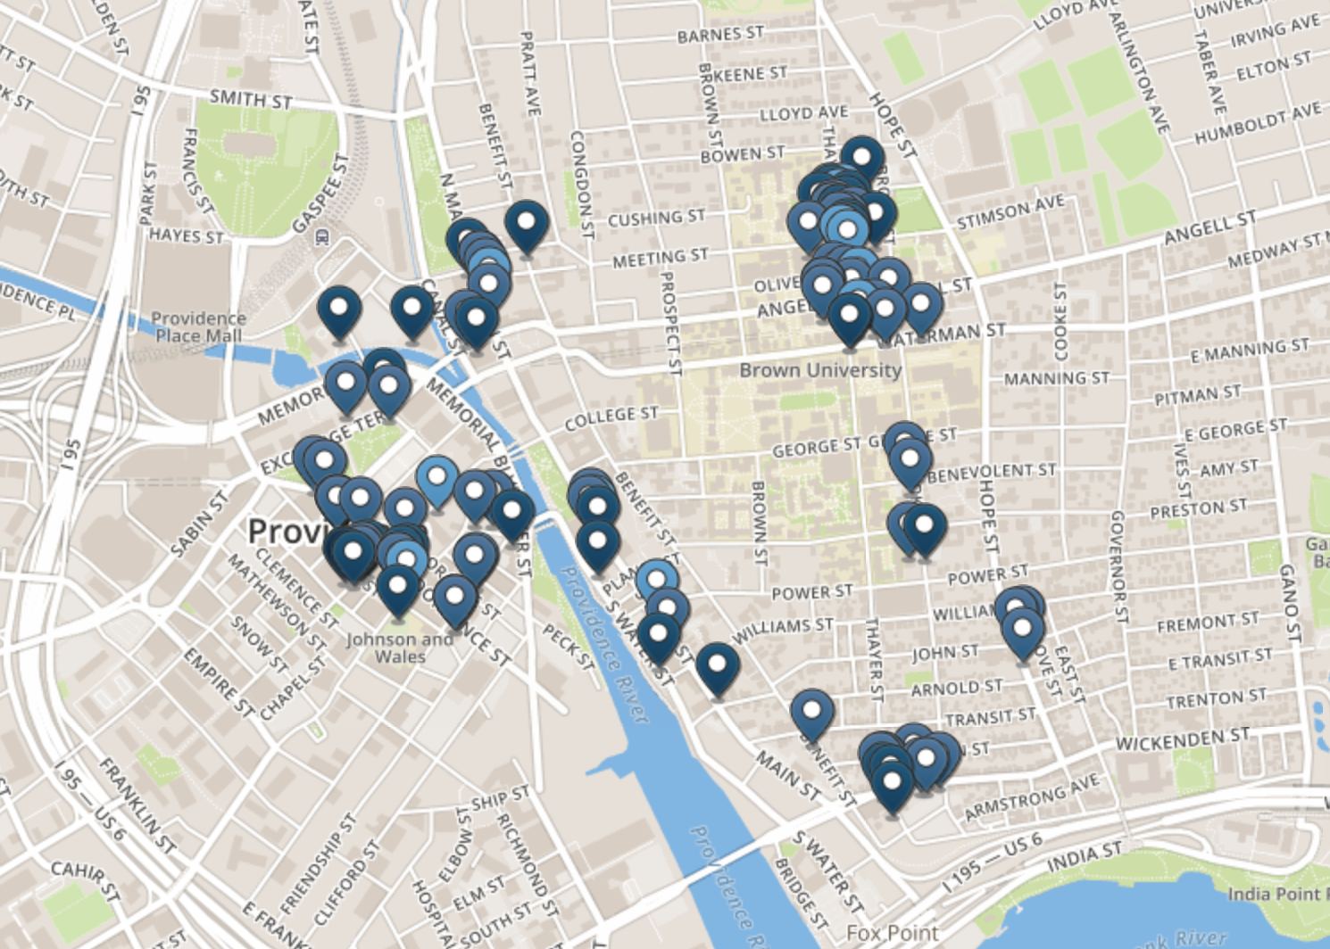
[Part 2] User – Map & Parallel Coordinates
Visualize what kinds of restaurants in New York city
Visualize the location of filtered restaurants near the user
[First window]
Show all the restaurants around user
Parallel coordinates: to show basic information of restaurants：
Number of review; stars; category ; keywords; distance; price
Map: to show the location after filter

Slide 10
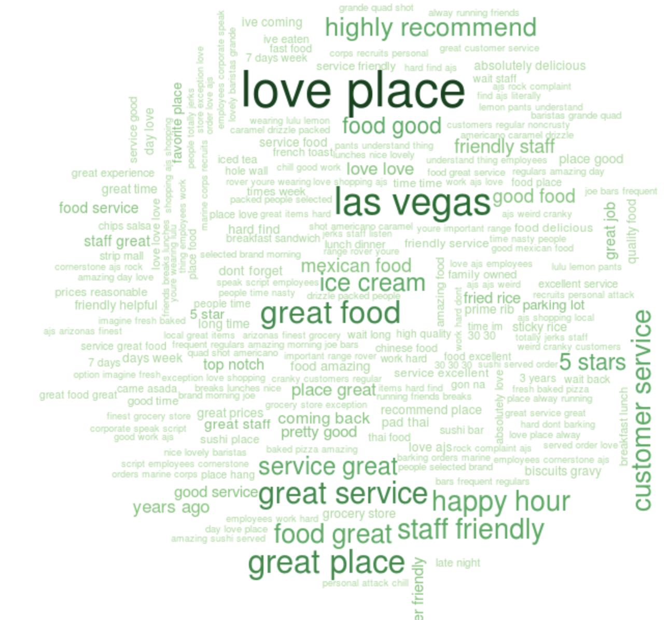
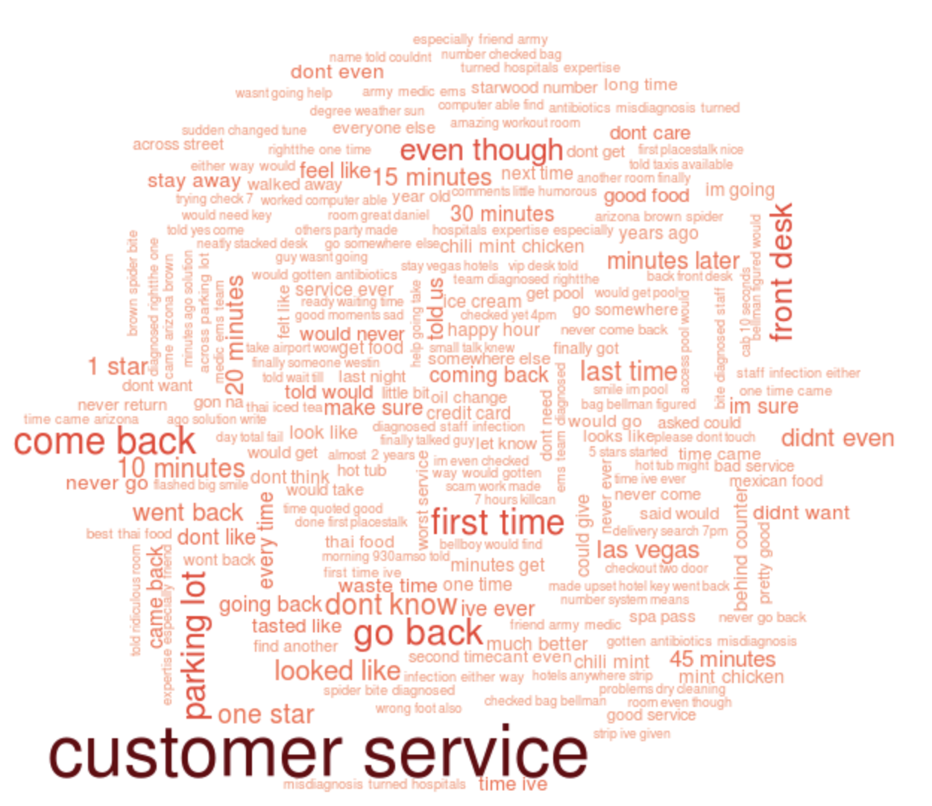
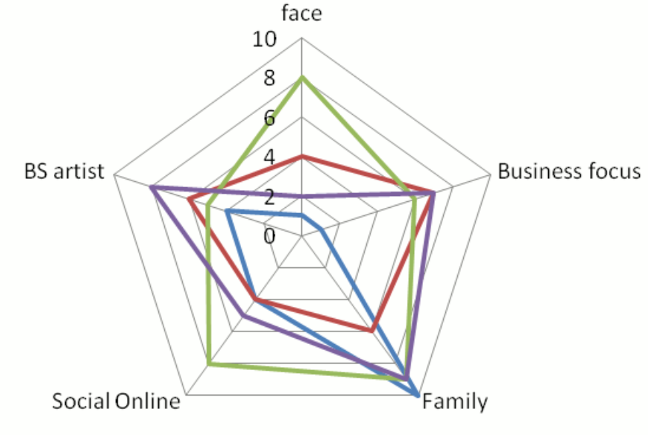
[Part 2] User – Word Cloud & Star Glyph
Visualize the positive and negative reviews
Visualize how the selected restaurant matches user’s preference
[Second window]
Show a specific restaurant information :
Word clouds: good and bad reviews
Star Glyph: different properties of restaurants
Number of review; stars; category ; keywords; distance; price

Slide 11

Thank You

